Slide 1
Chap 8 Symbol Table
name attributes
: :
Collect attributes when a name is
declared.
Provide information when a name is
used.
Two issues:
1. interface: how to use symbol tables
2. implementation: how to implement
it.

Slide 2
Chap 8 Symbol Table
Attributes in Symbol Table
1. Name : is used to differentiate one
token from other
2. Size : to know the memory requirement.
3. Dimension : to know whether it is
single / multi dimensional
4. Type : data type int/char/….
useful for type checking
5. Line of Declaration :
6. Line of Usage : to keep track of scope
information
7. Address : for code generation

Slide 3
Chap 8 Symbol Table
String space for Name Attribute
Should we store the identifiers in the
symbol table?
  Name lengths differ significantly.
  e.g. i, account_receivable,
    a_very_very_long_name
  Space is wasted if space of max
  size is reserved.
  Solution : store the identifiers in
  string space, and store an index
  and length in the symbol table.

Slide 4
Chap 8 Symbol Table
Ex.
1
8
13
20
a c c o u n t t e m p l b a l a n c e ......
string space
1
7
.....
symbol
table
.....
13
7
8
5
.....
Usually, symbol table manages the
string space.
Names in string space may be re-used.
Individual scopes may use different
string space. However, in block-
structured languages, a single string
space is good for re-claiming space
(when the name becomes invisible).
......
block 2
block 1

Slide 5
Chap 8 Symbol Table
How large is the string space?
too big waste space
too small run out of space
Solution : segmented string space
dynamically allocate 1 segment at
a time.
selector
:
:
:
offset length
We need (selector, offset, length)
to identify a name.

Slide 6
Chap 8 Symbol Table
A symbol table class
A symbol table class provides the
following functions:
1. create() : symbol_table
2. destroy ( symbol_table) : to destroy
3. insert (name, table) : pointer to an entry
4. lookup (name, table) : pointer to an entry
5. set_attributes (*entry, attributes)
6. get_attributes (*entry) : attributes

Slide 7
Chap 8 Symbol Table
Types of Programming Languages
Non Block Structured Languages - NBSL
  Create.
  Destroy
  Insert
  Lookup
Block Structured Languages - BSL
  Create.
  Destroy
  Insert
  Lookup
  Set
  Reset

Slide 8
Chap 8 Symbol Table
basic implementation techniques - NBSL
basic operations: insert() and lookup()
considerations: number of names
        storage space
retrieval time
organizations:
<1> Unordered list (linked list/array)
  Easy to insert
  Expensive lookup
<2> Ordered list
  Binary search on arrays
  Expensive insertion
  (+) good for a fixed set of names
    (e.g. reserved words, assembly
    opcodes)
<3> Binary search tree
  On average, searching takes
  O(log(n)) time.
  However, names in programs are
  not chosen randomly.
<4> hash table: most common
  (+) constant time

Slide 9
Chap 8 Symbol Table
Binary search tree
For balanced tree, search takes
O(log(n)) time.
For random input, search takes O(log(n))
time.
  However, average search time is
  38% greater than that for a
  balanced tree.
In worst case, search takes O(n) time.
e.g. ( A B C D E ) linear list
( A E B D C ) linear list

Slide 10
Chap 8 Symbol Table
Solution : keep the tree approximately
balanced.
e.g. AVL tree
T1 T2
| height(T1) - height(T2) |
1
Insertion/deletion may need to move
some subtrees to keep the tree
approximately balanced.

Slide 11
Chap 8 Symbol Table
(+) space = O(n)
[compare] hash table needs a fixed
size regardless of the number of
entries.
Application: Sometimes, we may use
multiple symbol tables. AVL is better
than hashing in this case.

Slide 12
Chap 8 Symbol Table
Hash tables
hash : name
address
hash is easy to compute
hash is uniform and randomizing.
Ex. (C1 + C2 + ..... + Cn) mod m
(C1*C2* ..... *Cn) mod m
(C1 + Cn) mod m
(C1 ) mod m
C2
.....
Cn

Slide 13
Chap 8 Symbol Table
Resolving collusions :
<1> linear probing
  Try h(n), h(n)+1, h(n)+2, ...
  Problematic if the hash table did
  not reserve enough empty slots.
<2> add-the-hash rehash
  Try h(n), (2*h(n)) mod m,
    (3*h(n)) mod m, ...
  m must be prime.
<3> quadratic rehash
  Try h(n), (h(n)+1) mod m,
    (h(n)+4) mod m, ...
<4> chaining
....
hash
table
chains

Slide 14
Chap 8 Symbol Table
Advantages of chaining:
  (+) less space overhead of the hash
  table
  (+) does not fail catastrophically
  when the hash table is almost full.
The chains may be organized as search
trees, rather than linear lists.
More importantly, we can remove all
names defined in a scope when the
scope is closed.
{ var a;
{ var a, b, c;
...
...
}
}

Slide 15
Chap 8 Symbol Table
Block-structured symbol table
Scopes may be nested.
Typical visibility rules specify that a
use of name refers to the declaration
in the innermost enclosing scope.
Ex.
begin int x;
begin real x;
begin
y:=x;
end
end
end

Slide 16
Chap 8 Symbol Table
Implication: when a scope is closed,
all declarations in that scope become
inaccessible.
Ex.
begin
.........
begin
int x;
real y;
type z;
:
:
end
/* x,y,z are inaccessible here */
:
:
y:=x;
end

Slide 17
Chap 8 Symbol Table
Symbol tables in block-structured
languages:
  1. many small tables
  2. one global table
<1> many small tables
  - one symbol table per scope.
  - use a stack of tables.
  - The symbol table for the current
  scope is on stack top.
  - The symbol tables for other
  enclosing scopes are placed under
  the current one.
  - Push a new table when a new scope
  is entered.
  - Pop a symbol table when a scope
  is closed.

Slide 18
Chap 8 Symbol Table
Ex.
begin
int H,A,L;
begin
real x,y;
:
:
end
begin
char A,C,M;
print(M);
H + A ..... ;
X + L ...... ;
end
end
A:char
C:char
M:char
:
H:int
A:int
L:int
stack
symbol table

Slide 19
Chap 8 Symbol Table
To search for a name, we check the
symbol tables on the stack from top
to bottom.
  (- ) We may need to search multiple
  tables.
  E.g. A global name is defined in
  the bottom-most symbol table.
  (- ) Space may be wasted if a fixed-
  sized hash table is used to
  implement symbol tables.
    - hash table too big -- waste
    - hash table too small -- collisions

Slide 20
Chap 8 Symbol Table
<2> one global table
- All names are in the same table.
- What about the same name is
declared several times?
    Each name is given a scope
    number.
    <name, scope number> should
    be unique in the table.

Slide 21
Chap 8 Symbol Table
Ex.
begin
int H,A,L;
begin
real x,y;
:
:
end
begin
char A,C,M;
print(M);
H + A ....;
X + L .... ;
end
end
scope
number
2
1
3
A(3)
L(1)
A(1)
C(3)
H(1)
M(3)
symbol table

Slide 22
Chap 8 Symbol Table
To search a name is easy.
New names are placed at the front of
lists.
To close a scope, we need to remove
all entries defined in that scope.
(We need to examine each list.)

Slide 23
Chap 8 Symbol Table
One global table cannot be implemented
with binary trees easily.
  - It is not easy to delete all entries
  declared in a scope when the scope
  is closed.
  - To find a name, we need to search
  the last entry (rather than the first
  entry).
Ex.
H(1)
A(1)
L(1)
A(3)
C(3)
M(3)
Consider the case when A is being
searched for.

Slide 24
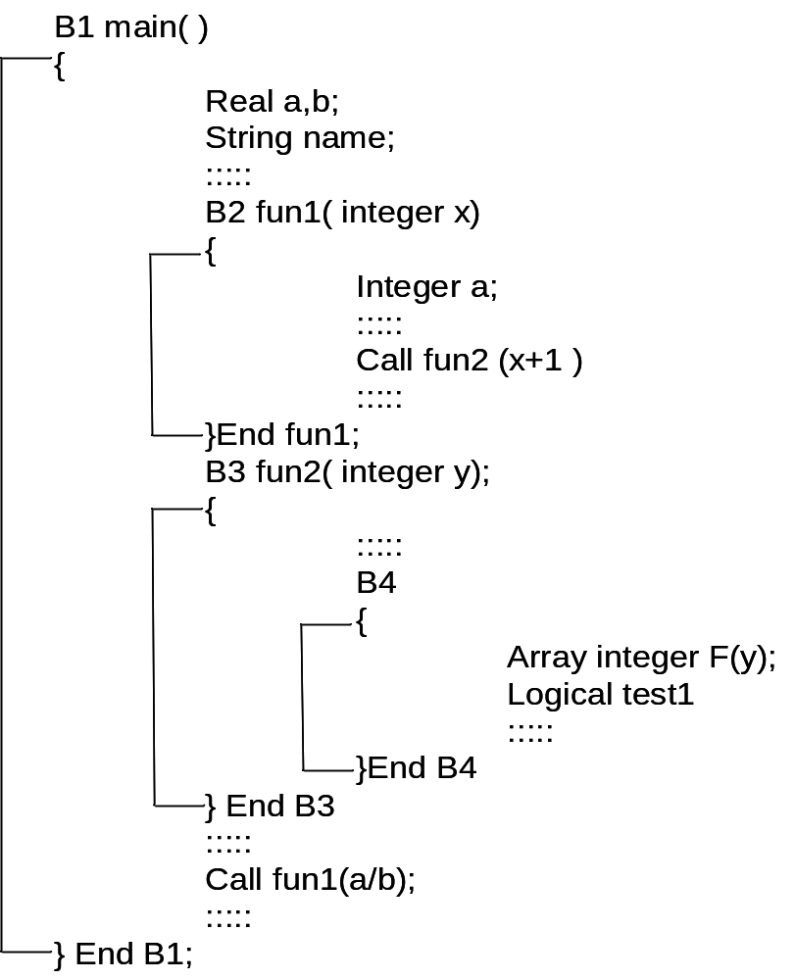
Chap 8 Symbol Table
Example program for Block Structured Language

Slide 25
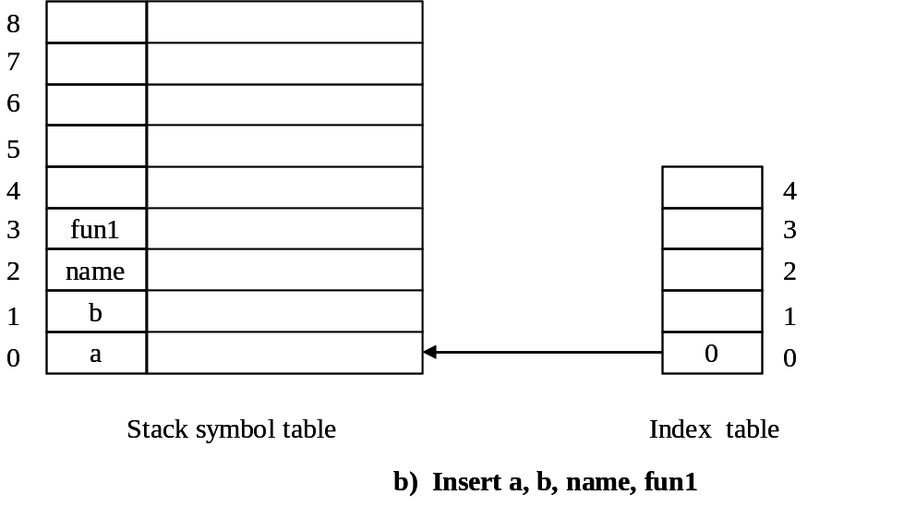
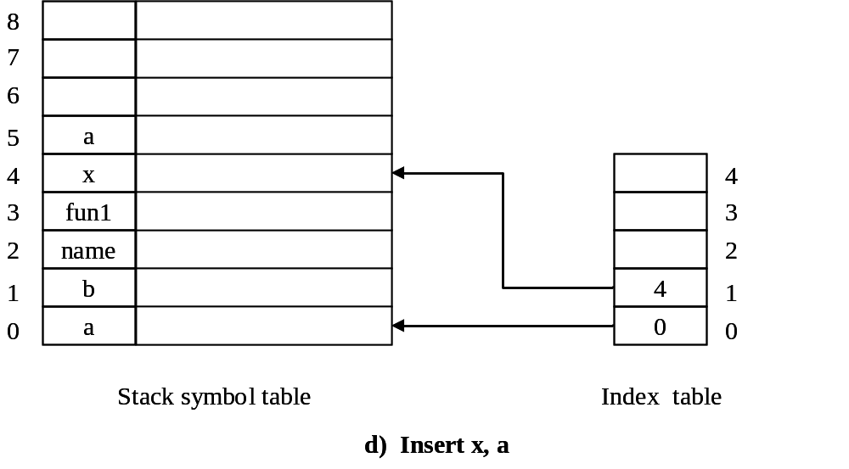
Chap 8 Symbol Table
Stack – Implemented linear structure
Symbol Tables
Insert a, b, name, fun1
Insert x, a

Slide 26
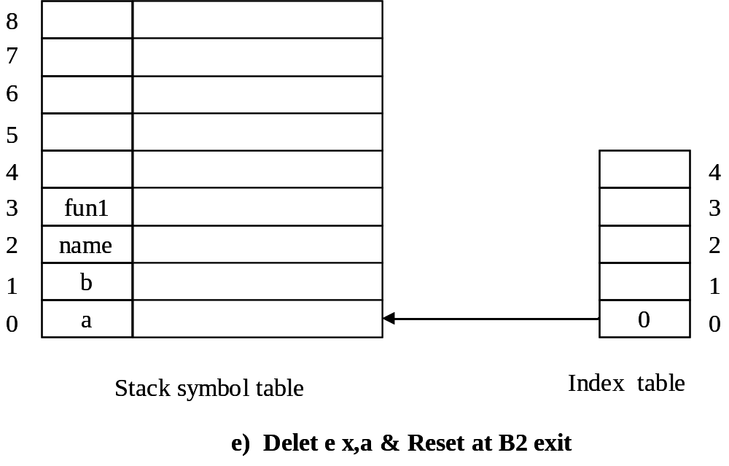
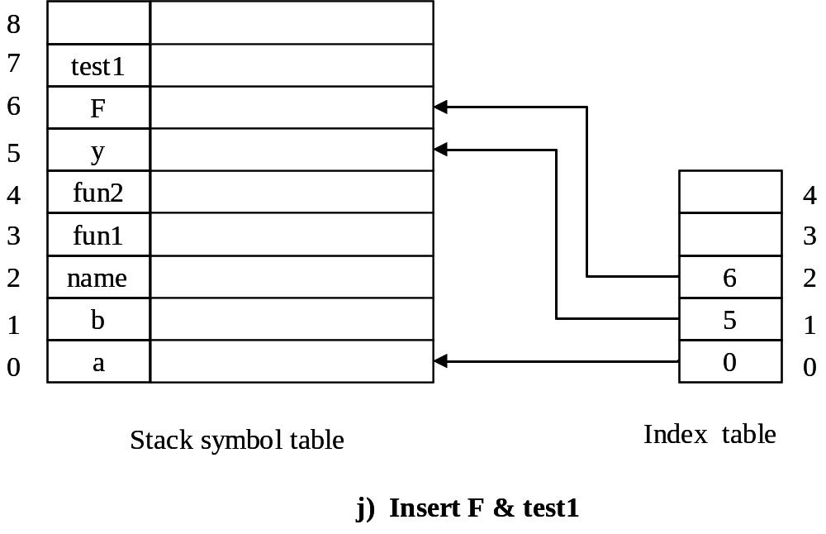
Chap 8 Symbol Table
Reset at B2 exit & Delete x, a
Insert F, test1

Slide 27
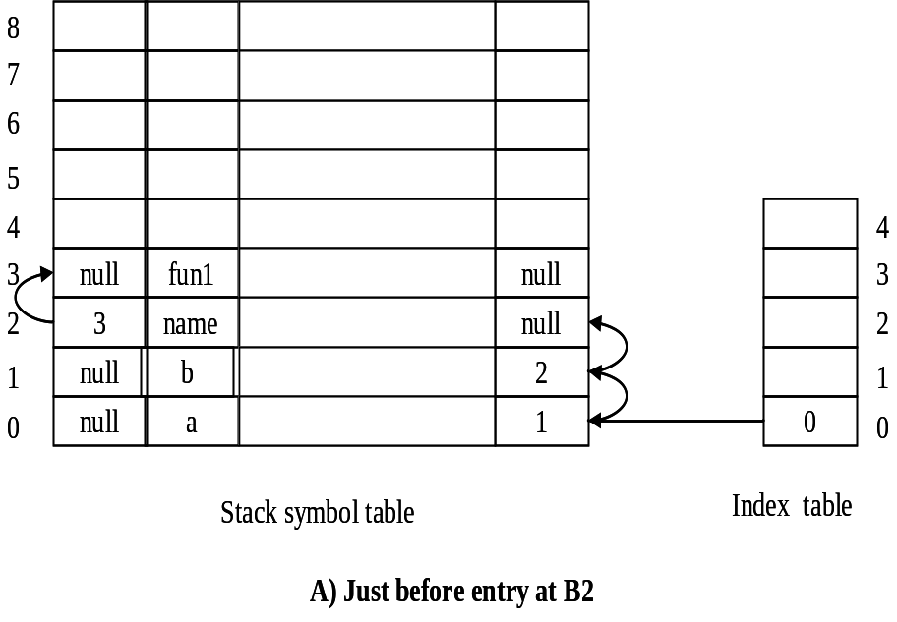
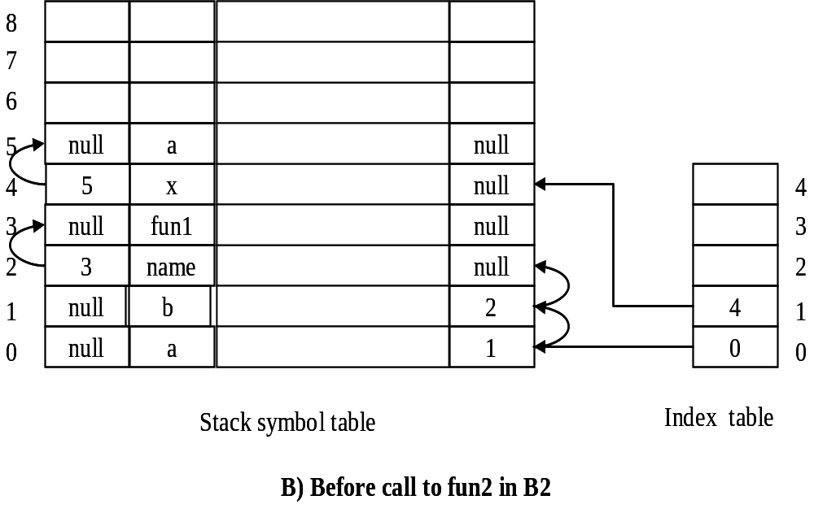
Chap 8 Symbol Table
Stack – Implemented Tree Structure
Symbol Tables

Slide 28
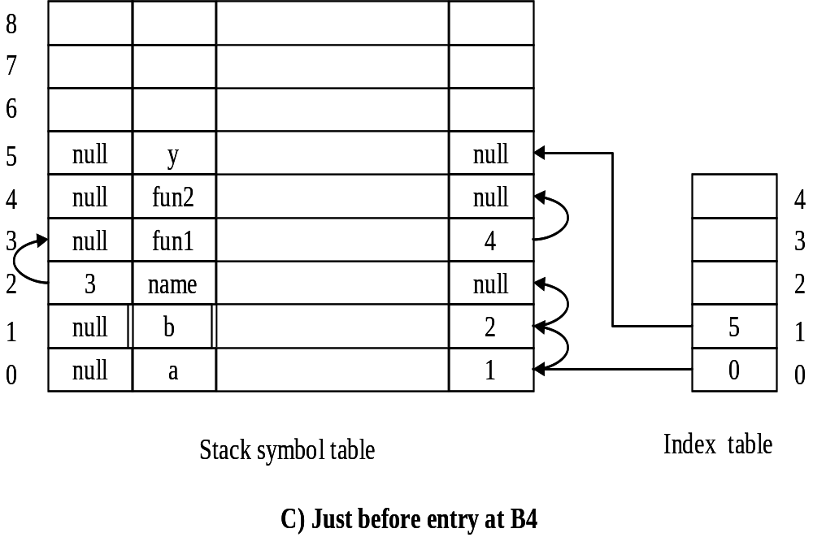
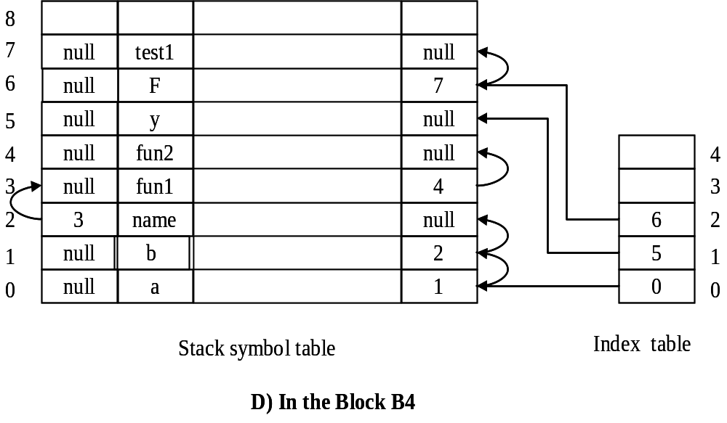
Chap 8 Symbol Table

Slide 29
Chap 8 Symbol Table
Stack – Implemented Hash – Structure Symbol Table
Variable Name | Sum of ASCII values | Total value(TV) | Mapping location (TV/10)
a | 97 | 97 | 7
b | 98 | 98 | 8
name | 110+97+109+101 | 417 | 7
fun1 | 102+117+110+49 | 378 | 8
x | 120 | 120 | 0
fun2 | 102+117+110+50 | 379 | 9
y | 121 | 121 | 1
F | 70 | 70 | 0
test1 | 116+101+115+116+49 | 497 | 7

Slide 30
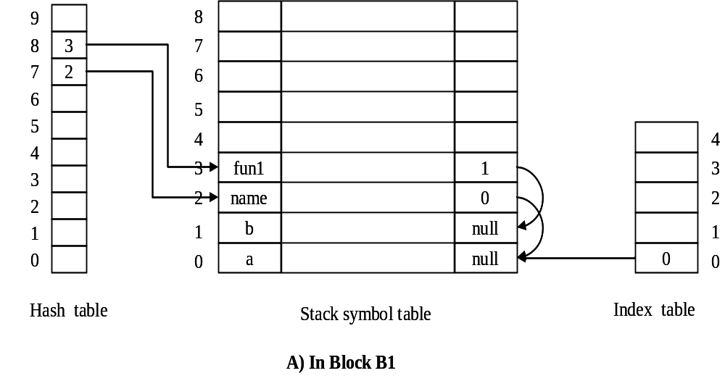
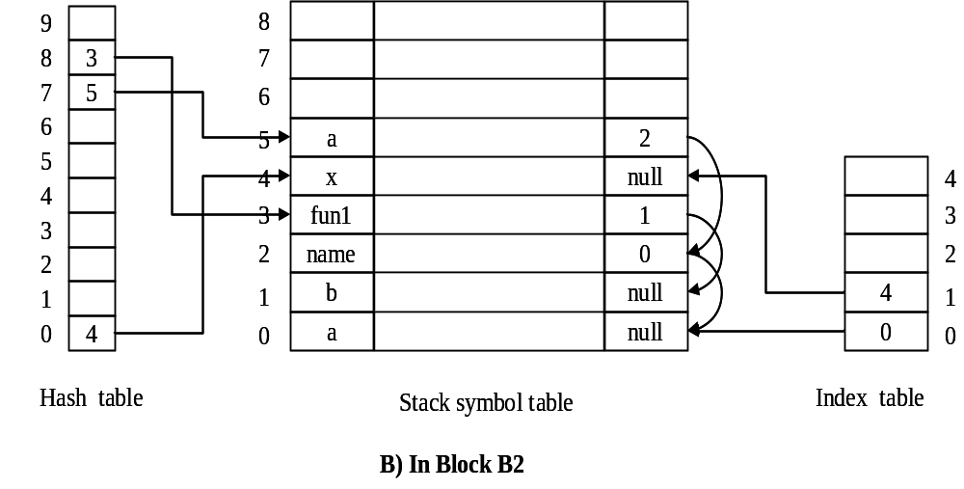
Chap 8 Symbol Table

Slide 31
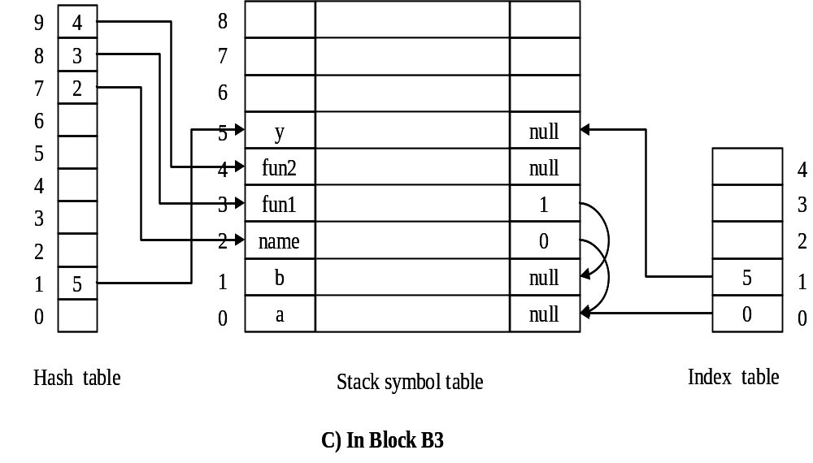
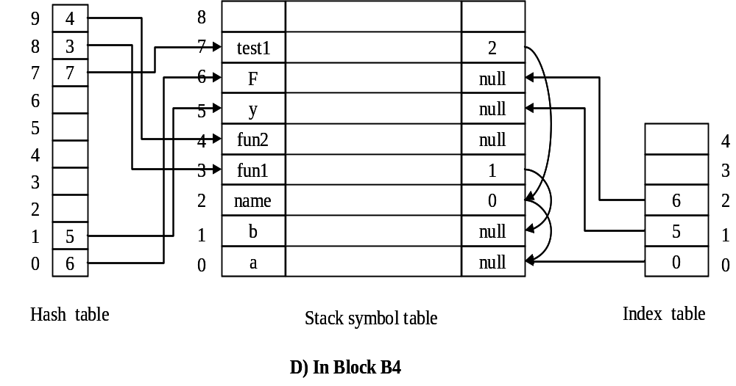
Chap 8 Symbol Table

Slide 32
Chap 8 Symbol Table
Comparisons:
many small tables one global table
simpler more complicated
slower faster search
less efficient efficient storage
(for hash tables) use
Need space for
scope numbers
hash table or trees Use hash tables
Good for keeping Good for 1-pass
symbol tables of compilers.
closed scopes Entries may be
discarded after
(e.g. in multi-pass the scope is
compilers). closed.

Slide 33
Chap 8 Symbol Table
Extensions to block-structured
  symbol tables
- issues :
  different visibility rules
  different search rules
  multiple uses of a name in the same
  scope
  implicit declaration
  use-before-define
Ex.
  1. qualified field name
  rec1.field1.field2
  2. import/export rules
  3. with statement in Pascal
  4. use statement in Ada

Slide 34
Chap 8 Symbol Table
two implementation approaches:
<1> duplicate all the visible names in
the current scope
(+) easy to implement
(- ) significant space overhead
<2> use flags in symbol table entries
to control visibility
(- ) more complicated
(- ) slower
(+) less space overhead

Slide 35
Chap 8 Symbol Table
Fields and records
The only restriction of field names is
that they be unique within the record.
1
Ex. A : record
A : int;
X : record
A : real;
B : boolean;
end
end
2
References to fields must be completely
qualified. Ex. A
A.A
A.X.A
In PL/1 and COBOL, incomplete
qualifications are allowed.

Slide 36
Chap 8 Symbol Table
HOW TO HANDLE FIELD NAMES?
<1> one small table for each record type
The table is an attribute of the record type
  Ex. R.A Find R
Find A in R s symbol table
  (+) easy to implement
  (- ) waste space if hash table is used,
  but good for a binary tree.
<2> treat field names like ordinary names.
- Put them in the same symbol table.
- Need a record number field
(like scope number).
- Each record type has a unique
record number.
  Ex. R.A Find R
Find A with record
number of R s type.
- For ordinary names, the record
number is 0.
??,
‘
,
‘
,
‘

Slide 37
Chap 8 Symbol Table
8.4.2 export
Compare:
  visibility rule: names are not visible
outside.
  record rule: all names are visible
outside with proper
qualification.
  export rule: some, but not all, of the
names are visible outside.
Export rules are for modularization.
e.g. Ada packages, MODULA-2 modules,
C++ classes.
Ex. module IntStack
export push,pop; export rule
const max=25
var stack : array[1..max] of int;
top : 1.. max
procedure push(int);
procedure pop() : int;
begin top:=1; end IntStack;

Slide 38
Chap 8 Symbol Table
How to handle export rules?
begin
module
export A,B,C;
int A,B,C;
:
:
end
When a scope is closed, move
all exported names outside.
end
How to find all exported names when a
scope is closed?
1. When a hash table +
collision chains is used
-- scan each list.
2. When a binary tree, one
for each scope, is
used for each scope
-- cluster at the root.
For
export
located
at the
beginning

Slide 39
Chap 8 Symbol Table
Implementation:
  - Each name has a boolean exported
  attribute.
  - Use a close_scope() procedure to
  handle exported names.
For Ada packages,
package IntStack is
procedure push(int);
function pop(): int;
end package
specification
(exported)
package body IntStack is
max: const int := 25;
stack: array ......
top: int;
procedure push() { .... }
function pop ....
begin top := 1; end IntStack
implementation

Slide 40
Chap 8 Symbol Table
The specification part of a package is
exported.
The exported names are used with
qualifications, e.g. IntStack.push.
They can also be imported with use
clauses.
How to handle packages?
  <1> one small table per package (like
  one table per record type).
  <2> If one big table is used, insert a
  end-of-search mark at each chain.
EOS
for ordinary
names
for package
local
specification
Use clauses and qualified
references may pass beyond
EOS during search.

Slide 41
Chap 8 Symbol Table
Modular-2 is similar to Ada:
definition module IntStack
export qualified push, pop;
procedure push(int);
procedure pop: int;
end IntStack
implementation module IntStack;
.......
end
All exported names are accessed with
qualifications, e.g. IntStack.push().

Slide 42
Chap 8 Symbol Table
- Separate compilation
Packages/modules may be compiled
separately.
When package specification (or module
definition) is compiled, the information
is saved in a library.
The information is used to compile
package body or other packages.
The information allows complete static
checking.
One table per package is most suitable
for separate compilation.
C uses #include
  - less efficient
  - sometimes inconsistent.

Slide 43
Chap 8 Symbol Table
8.4.3 import rules
Two kinds of scopes:
  - importing scope: e.g. Pascal
  - non-importing scope:
  e.g. modules in Module-2
In some languages, non-local objects
can be imported with restrictions,
e.g. read-only.
Non-local objects must be imported
level by level.
C++ provides three classes of visibility
- private
- protected
- public
for subclasses and
friends
for general public

Slide 44
Chap 8 Symbol Table
var x;
var x
export x
import x;
x
x
export: to the outside
import: to the inside

Slide 45
Chap 8 Symbol Table
Ex. of import
module thingStack
import Thing;
var stack : array [1..3] of Thing;
......
end
- Purpose of import rules:
more precise control
(for increasing reliability)

Slide 46
Chap 8 Symbol Table
- Implementation
<1> modify search operation
    Find the name
    check the scope of the name
      definition against any
      non-importing scopes
var x;
non-importing scope
.... ....
x
<2> process import statements
For an import statement
import thing;
create entries for the imported
names in the current scope.

Slide 47
Chap 8 Symbol Table
The above method works well as long
as not many names are imported, but is
problematic when many names are
imported. Consider
var A,B,C, ... ,Z;
import A,B,C, ... ,Z;
import A,B,C, ... ,Z;
import A,B,C, ... ,Z;
- Many entries will be created.
- Solution: use max-depth field for each
name. (This is the maximum depth of
nesting scope in which a name may
be seen.)

Slide 48
Chap 8 Symbol Table
The max-depth field is set
  - when the name is declared, or
  - when the name is exported, or
  - when the importing scope is closed.
difficulty: The entire symbol table must
be searched to find and modify certain
entries when a scope is closed.
  - Some production compilers actually
  do this!
  - We may move the imported names
  to the head of chains for easy
  modification.

Slide 49
Chap 8 Symbol Table
8.4.4 Altered search rules
1. with statement
2. qualified names
3. use clause in Ada

Slide 50
Chap 8 Symbol Table
<1> with statement
  Ex. with R do <stmt>
    Within <stmt> a name is searched
    in the following order :
    1. fields of record R
    2. other scopes in the normal
    order
  To process with statements,
  1. easy if each record and each scope
  has its own symbol table.
  (Use a stack of symbol tables.)
  2. for a single big table,
  2.1. open a new scope
  2.2. keep a stack of all open with
  stmts

Slide 51
Chap 8 Symbol Table
<2> qualified names
Ex. IntStack.A
,
Find IntStack s symbol table or
scope number
Find A in that symbol table or in that
scope
[similar to record s fields]
,
- In Ada/CS, packages do not nest.
Things are simpler.
- In Ada, packages may nest.

Slide 52
Chap 8 Symbol Table
<3> use clause in Ada
  Ex. use pkg1,pkg2;
    Names in pkg1 and pkg2 will
    become visible.
  - two rules:
  1. local definition has precedence
  if a name is defined both locally
  and in pkgs.
  2. If a name is defined in both pkg1
  and pkg2, the name is not directly
  visible.

Slide 53
Chap 8 Symbol Table
Solutions :
1. Enter names in packages into symbol
table -- expensive if package is big.
2. Search a name in symbol table.
If the name is not found in local
table, search all packages.
3. similar to (2).
After a name is found, put it in local
symbol table to avoid repeated search.

Slide 54
Chap 8 Symbol Table
8.5 Implicit Declaration
Ex. FORTRAN implicitly declares
variables (plus their types).
Ex. Algol 60 implicitly declares labels.
Ex. Ada implicitly declares for-loop
indices and open a new scope.
i : integer;
for i in 1..9 loop
........
end loop;
different i
Solution for Ada :
  Actually create a new scope.
    or
  Put a loop index in the same scope
  but possibly hide an existing name
  temporarily.

Slide 55
Chap 8 Symbol Table
,
Ex. labels in Pascal
In Pascal, label declarations and label
usages do not mesh well. Specifically,
we may not be able to jump to a label
within the scope of its declaration.
Ex. label 99;
begin
......
for i:=1 to n do begin
99: x:=x+1;
end
goto 99; illegal
99.....
end
Solution: Mark the label (99) as
inaccessible outside the for-loop.

Slide 56
Chap 8 Symbol Table
8.6 Overloading
In most languages, a name may denote
different objects.
Ex. In Pascal, a name may denote a
function and its return value.
function abc() : integer
begin
abc := abc + 1;
end
Ada allows much general overloading.
as return value
as a function
procedure names
function names
operators
enumeration literals
may be
overloaded
Ex. function + (X,Y:complex):complex
function + (U,V:polar):polar

Slide 57
Chap 8 Symbol Table
Ex.
type month is (Jan,Feb,...,Oct,Nov,Dec);
type base is (Bin,Oct,Dec);
The new Oct overloads, rather than
hides, the old Oct.
There are algorithms to determine the
meaning of an overloaded name
(chap 11) in a given context.
C++ allows operators (+,-,[ ], ....)
to be overloaded.

Slide 58
Chap 8 Symbol Table
How to accommodate overloading in
symbol table?
  Link together all visible definitions of
  an overloaded name.
  When an overloaded name is used, all
  the definitions are available. Then we
  can choose an appropriate one.
  Establish the link when an
  overloaded name is defined.
  Purge the link when a scope is
  closed
  To ease purging, order the link by
  scope.
+
+
+
+
+
+
...
innermost
scope
outermost
scope

Slide 59
Chap 8 Symbol Table
Ex. in Pascal
program
function abc() : integer;
begin
:
:
end
begin
:
:
end.
At this point,
abc int
abc func
At this point,
abc func

Slide 60
Chap 8 Symbol Table
8.7 Forward Reference
In Pascal, pointer types may introduce
forward references.
type T = integer;
procedure abc();
type P = T;
:
:
type T = real;
which T
does this T
refer?
P is a pointer-to-real type.

Slide 61
Chap 8 Symbol Table
Same problem for non-local goto in
Algol 60.
L :
.....
proc abc();
begin
goto L;
:
:
L :
which L does this
L refer to?
.....
end

Slide 62
Chap 8 Symbol Table
In the most general case
Suppose x may be a forward reference.
var x;
.....
x
.....
scopes
  Need to check scopes from inside out.
The Pascal label problem is simpler
since labels have to be declared.
This is why most languages require
declarations proceede statements.

Slide 63
Chap 8 Symbol Table
How to forbid forward reference?
In Pascal, constants cannot be forward
referenced. Then consider
const c=10
procedure abc();
const D=C;
:
:
const C=20;
begin ... end
- So what is the value of D? error!
- It is not easy to detect this error.
- Most Pascal compilers cannot detect
this error, including SUN pc.
- Due to this difficulty, Ada changes the
visibility rule.

Slide 64
Chap 8 Symbol Table
How to handle forward reference?
  We need more than one pass.
  Collect all definitions.
  Process declarations and stmts.
For Pascal pointer type,
  link together all references to type T.
  determine the real T after the type
  section is completely examined.
For goto label, use backpatch in one
pass.
More general forward references,
e.g. in PL/1,
A = B + C
INT A, B, C;
must be processed in multiple passes.

Slide 65
Chap 8 Symbol Table
To detect illegal forward reference,
const c=10;
procedure abc;
const d=c;
const c=20;
at this point, assume
c is imported.
at this point, we
find c is in
conflict with
the imported c.
In general, assume x may be forward
referenced.
var x
.....
x
.....
x is implicitly
imported at
these points.

